Slide 1
Final Project:
Open Source Geospatial Database
Increasing Access to Global Event Data
Group 8: Thomas Keeley, Jingya Gao, Yon ho Cheong

Slide 2
Project Overview
Part1. Project Definition
Scope of the project
Data sources (ACLED, GDELT)
Data flow
Features that will be implemented
Expected outcomes
Part2. Project Architecture
Logical architecture of the project indicating AWS cloud services
Part3. Project Implementation
Cloud services in action
Inputs and outputs consumed and produced, respectively

Slide 3

Part1. Scope of the Project
Scope
Problem
Response
Global Event Data
Abundant resources available as Open Source
Particular interest in accessing data that can describe an event with geographic precision
Accessibility
Open Source data not as easily accessible in classified environment
Voluminous geo-event data should be securely available to enhance intelligence gathering
Increase Availability
Collect/collate multiple Geospatial datasets
Store in private database
Data to be controlled and accessed within classified environment
Query and export

Slide 4

Dataset
Format
ACLED Dataset
GDELT Dataset
The Armed Conflict Location & Event Data Project
ACLED includes data from 1997 to the present
Monitors political violence and protest in the developing world
Captures types of events, dates and locations of political violence, Actors , the groups involved, reported fatalities
ACLED Data Source Link: https://www.acleddata.com
The Global Database of Events, Language, and Tone
GDELT includes data from 1979 to the present
Monitors the world's broadcast, print, and web news from nearly every country
Captures what's happening around the world, what its context is and who's involved, and how the world is feeling about it
GDELT Data Source Link: https://www.gdeltproject.org

Slide 5
Data Flow
Format
Access
Management
Tabulated collection of events and reports
Each record has unique ID
Geographic attribution
Actors involved
Event description
Source
Data will be available to query by attribute (Country, Year, Fatalities, etc….)
Data can then be exported and analyzed
Visualization process could be applied
Significant amount of ETL required in consistent data update
Amazon services available for ETL management
Potential for automated process
Notes:
Data flow indicating how data will be ingested, clean up, processed, and released
Format: specific dates, geographic attribute, actor or group involved, event types and description, and a data source
Management: AWS Glue is a fully managed ETL service that makes it simple and to categorize your data, clean it, enrich it, and move it between various data stores.

Slide 6
Implemented Features
Database: Amazon RDS
A web service that makes it easy to set up, operate, and scale a relational database in the cloud.
It provides cost-efficient and resizable capacity while managing time-consuming database administration tasks for you.
Amazon RDS supports the MySQL, SQL Server, Oracle and PostgreSQL database engines.
Storage: Amazon S3
Provides a highly durable and reliable data storage infrastructure for storing and retrieving any amount of data, at any time.
Compute: Amazon EC2; Amazon EC2 Auto Scaling
Amazon EC2 delivers scalable, pay-as-you-go compute capacity in the cloud.
Amazon EC2 Auto Scaling helps you maintain application availability and allows you to dynamically scale your Amazon EC2 capacity up or down automatically according to conditions you define.
Notes:
https://aws.amazon.com/govcloud-us/details/

Slide 7
Implemented Features (contd.)
Management & Governance: AWS Auto Scaling
Lets you build scaling plans for resources including EC2 instances and DynamoDB tables and indexes.
Networking & Content Delivery: Amazon VPC; NAT Gateway
Provision a private, isolated section of the Amazon Web Services (AWS) Cloud where you can launch AWS resources in a virtual network that you define.
AWS Transit Gateway is a service that allows you to easily scale connectivity across thousands of Amazon VPCs, AWS accounts, and on-premises networks.
Security, Identity & Compliance: AWS IAM
AWS Identity and Access Management (IAM) enables you to manage access to AWS services and resources securely. Using IAM, you can create and manage AWS users and groups, and use permissions to allow and deny their access to AWS resources.
Notes:
Amazon VPC: Without a VPC, EC2 instances connect to each other like spider webs so it will be hard to manage
If you apply a VPC, you can configure the network for each VPC and set up the network settings differently for each VPC

Slide 8
Our Expected Outcomes
Result
Access to Open Source global event data in secure environment
Trusted collection of abundant data scripted to automatically extract updated data
Data easily queried and exported
Enhanced intelligence gathering
Demonstrate capability of producing data driven intelligence

Slide 9









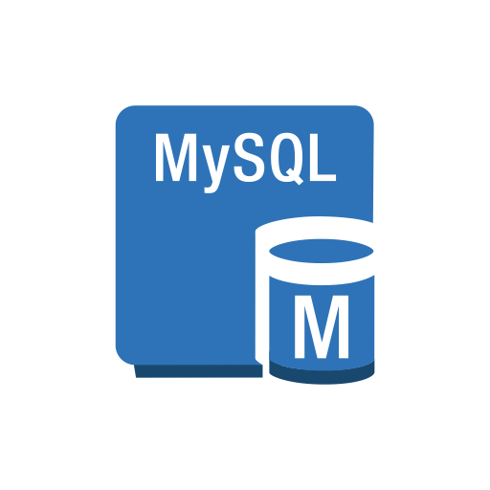




Part2. Architecture
AWS Cloud
Security Group
Public Subnet
Private Subnet
Private Subnet
Amazon S3
Administrator
EC2 Instance
Internet
Users
IAM Role
EC2 Instance
MySQL instance
Internet
NAT Gateway
Auto Scaling Group
Notes:
https://aws.amazon.com/architecture/icons/

Slide 10
Part3. Project Implementation
- Create a Virtual Private Cloud(VPC) with both private and public subnets.
- Create a second private subnet.
- Create a security group that has private access to an RDS Database Instance.
- Add the two private Subnets to the subnet group.
- Ensure that the availability zone is different for each.
VPC
Security Group
Private Subnet
Security Group
Subnet Group
- Create Security Group for a public web server that allows SSH from the Internet.
- Create a Subnet group from previously created Subnets.
- These will be the designated Database subnets for a DB Instance created under the specified VPC.

Slide 11
Part3. Project Implementation (contd.)
- Launch an Ubuntu Instance for database access.
- This instance will be extra large as it will facilitate the loading of very large datasets into the MySQL database.
- Use commands to view the distribution of memory across the instance.
- In order to utilize the additional storage, it must be distributed to the working directory of the instance.
- Create a MySQL database.
- This database will be created as “Dev/Test”.
Database
Ubuntu Instance
Memory Distribution
Database Setting
Ubuntu Instance
- A total of 150 gb of storage will be allocated.
- Launch the database as a multi-availability zone deployment with a standby instance.
- Connect the DB to previously created VPC and Subnet Group.
- Attach Ubuntu Instance to an Auto Scaling Group.
- Modify volume attached to instance to 200 GiB.

Slide 12
Part3. Project Implementation (contd.)
- Uploads files starting in 2013 into Ubuntu Instance.
- Create a new directory to hold GDELT data.
- Download every zip file in the web directory.
- Unzip every file and delete the original.
- Create IAM roles for group member access.
- Create user access to EC2 Instance.
- Grant password authentication on EC2 Instance.
- Create an S3 bucket to store ACLED Data.
GDELT
S3 Bucket
IAM Roles & User
Programming and Analysis
GDELT
ACLED
- Create a shell script that accesses the Database and create a table for every year of events in our events directory.
- Create a shell script that upload all ~2500 csv files into the Database tables by year.
- Upload all ACLED Data.
- Install Fuse in the Instance, access S3 bucket and download ACLED Data into instance.
- Create shell script that creates table in ACLED database to store all events.
- Create shell script to upload all ACLED data.

Slide 13

Demo
Github
https://github.com/thomaskeeley/CloudComputing

Slide 14
References
https://aws.amazon.com/products/databases/
https://aws.amazon.com/govcloud-us/details/
https://acleddata.com/curated-data-files/
http://data.gdeltproject.org/events/index.html
https://www.acleddata.com/wp-content/uploads/dlm_uploads/2017/10/API-User-Guide.pdf
https://aws.amazon.com/blogs/database/building-a-modern-application-with-purpose-built-aws-databases/
https://aws.amazon.com/getting-started/tutorials/create-connect-postgresql-db/
https://github.com/keplergl/kepler.gl/blob/master/docs/keplergl-jupyter/user-guide.md
https://spatial.blog.ryerson.ca/2019/11/18/create-quick-dashboard-with-kepler-gl-and-jupyter-notebook/
https://aws.amazon.com/blogs/database/query-your-aws-database-from-your-serverless-application/
https://aws.amazon.com/big-data/datalakes-and-analytics/
https://aws.amazon.com/lake-formation/
https://aws.amazon.com/solutions/data-lake-solution/

Slide 15
THANK YOU!
QUESTIONS?

